Slide 1

SQL HACKATHON 08/18/2022 – 08/25/2022
Team Data Hunters
Pradnya Kavale Ayesh Gaur
Uma Sirisha B Sarala Sureshkumar
With PMPO: Aleesha Pacheco

Slide 2

INTRODUCTION
During this SQL Hackathon, our team worked on Hospital Database to store, manage, query, and retrieve data as per the requirement.
Tools & approaches we used
We used Relational DataBase
Management SystemTool PostgreSQL (pgAdmin4)
in order to execute our queries.
We analyzed ER diagram to get good
understanding of the DATA MODEL and
discussed about optimization
Distributed queries within teammates
Peer review

Slide 3
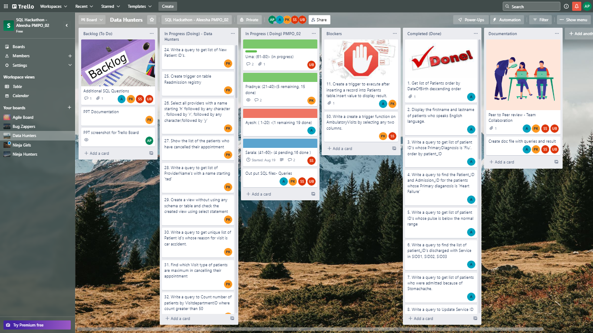
Agile Methodology

Slide 4
Functions & DataTypes
DataType
SERIAL
text
Keywords
AT TIME ZONE
ILIKE
FETCH
Date/Time
EXTRACT()
AGE()
Date_Part()
Now()
Date()
Window
First_Value()
RANK()
PERCENT_RANK()
ROW_NUMBER()
String
CONCAT()
CHAR_LENGTH()
SPLIT_PART()
TO_CHAR()
INITCAP()
LOWER()
REPLACE()
Database Admin
PG_DATABASE_SIZE()
VERSION()
Mathematical
ROUND()
TRUNC()
AVG()

Slide 5
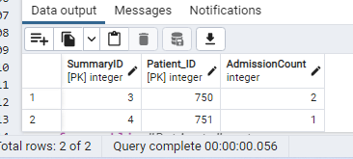
Innovative Solutions
In Q.25 while creating trigger, we calculated number of times the patient is admitted. This data was not directly accessible through existing table.

Slide 6

Challenges
Understanding the requirement for few of the queries
Figuring out ways to optimize queries
Learning and using new functions
To find trigger functionality
Formulation Extra questions

Slide 7

Thank You

